Slide 1
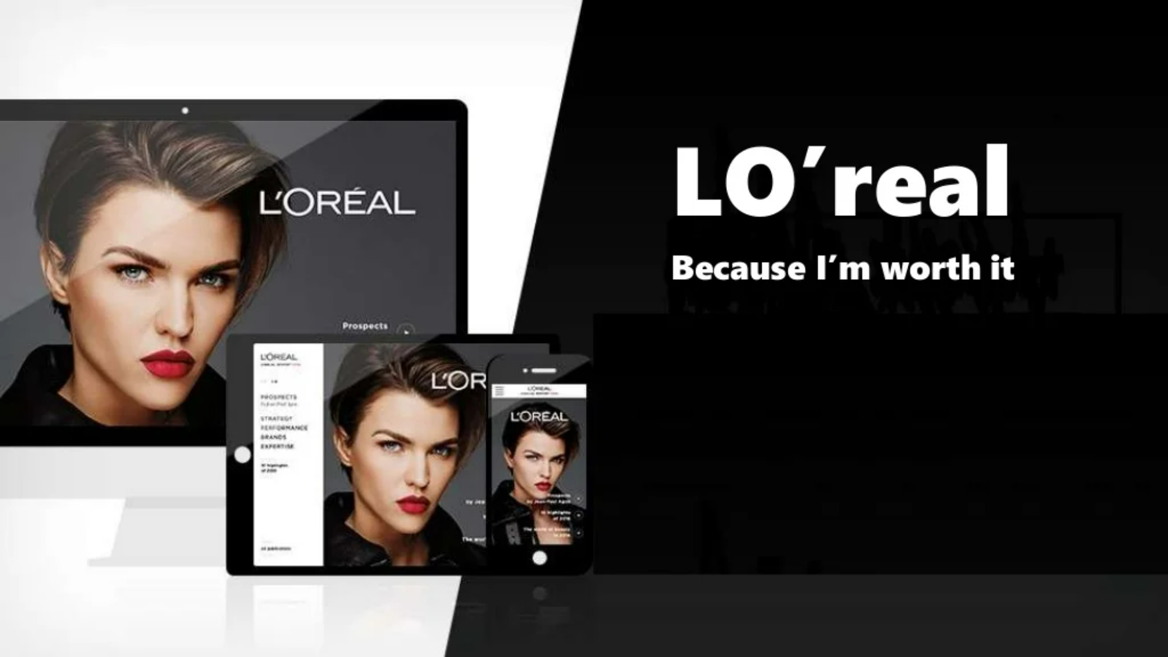
Members of Group 6:
Arjun M | PGP38177
Sourav | ABM19022
Anjali Bharti | PGP38175
Ayush Sharma | PGP38178
Mohaan T | PGP38193
Brinda Jena | PGP38179
Singhal Himanshu | PHD23012
Manoj Kumar | PHD23034

Slide 2
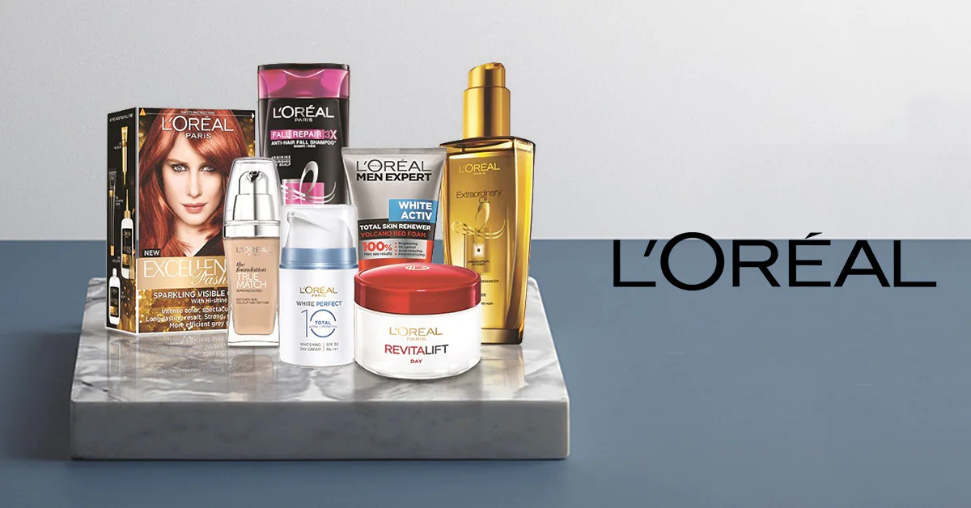
About L'Oréal
Headquartered in Paris, France founded by Eugene Schuller in 1909.
Website: www.loreal.com
Well segmented product offerings and distribution in 150 countries.
88k Employees, 36 global brands and $31 billion in sales
In 2021, L'Oréal had a market capitalization of $200 billion with $10 billion spent on advertising and promotion.
Some of its iconic brands are YSL, Ralph Lauren, L'Oréal Paris, Maybelline, Garnier, Kerastase, Vinchy and Redken.

Slide 3

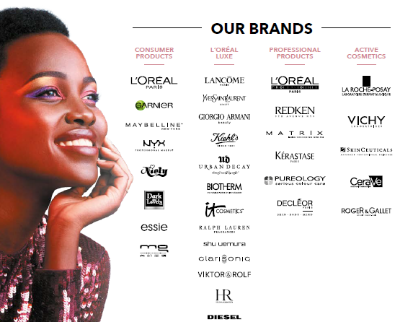
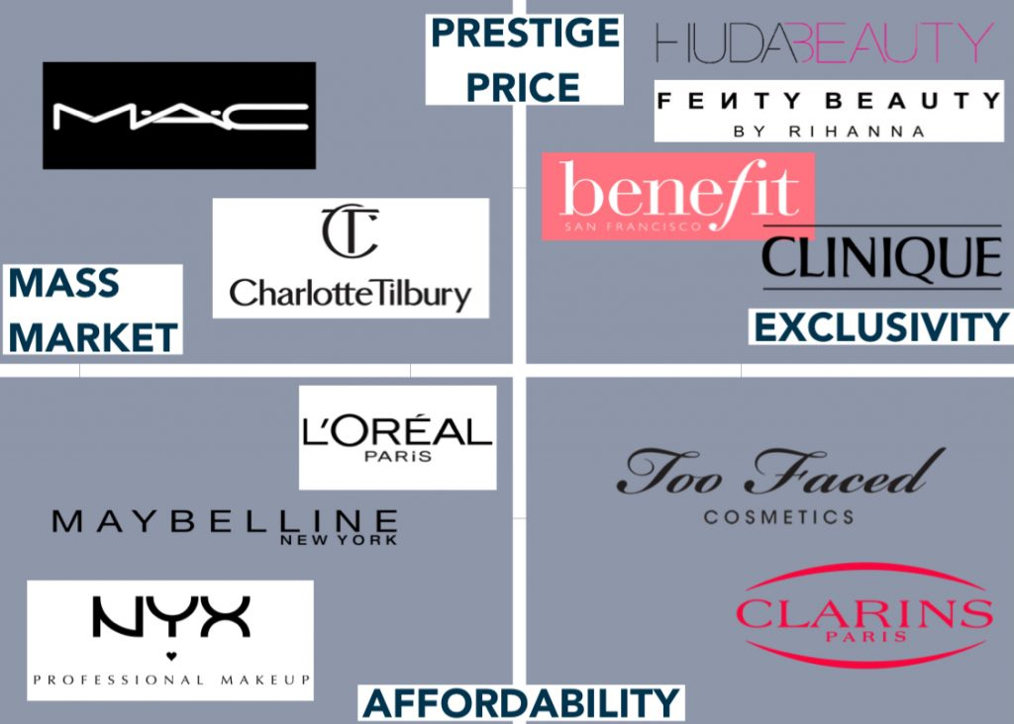


Brand portfolio & customer segments
Consumer product
52% of sales and offers
Distributed in mass retailing channel including hypermarkets, supermarkets, drug stores.
L'Oréal Luxe
27% of sales and offers
Available at department stores, boutiques, travel retail stores and dedicated websites.
Professional product
14% sales and offers
Available at haircare and skincare salons
Active Cosmetics
7% of sales and offers
Available at Healthcare outlets

Slide 4



Key strategy of L'Oréal
Precise target Marketing
Targeting right audience with right product
Minimal overlapping of each market segments
Expanding the empire by buying local beauty companies
Revamp bought out company with strategic direction
Entering new market areas
L'Oréal bought Soft Sheen in 1998, Carson products in 2000 and merged them, SoftSheen-Carson is now the market leader in ethnic hair-care industry.

Slide 5
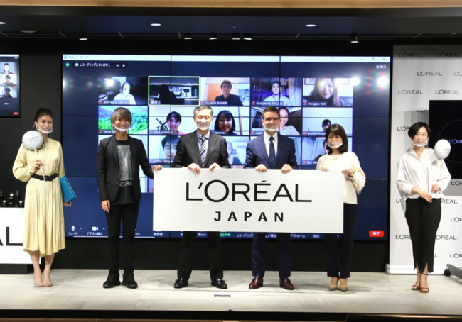
Keys to successful local product launches
Enriching collection year after year to embrace new segments and geographies
Respond to new customer demands
Does not stop at simply expanding its own brand globally, it has made an emphasis to launch specific products at the local and regional levels
Local and regional palates must be considered in every marketing decision made

Slide 6

SWOT
S
W
Too Many Subdivisions
Big Competition in Cosmetics Industry
Innovation
Different Range of Products
Strong Demand in Organic Products
Product Mix Expansion
O
T
Global Economic Crisis
Dynamic Nature of Cosmetics Industry

Slide 7
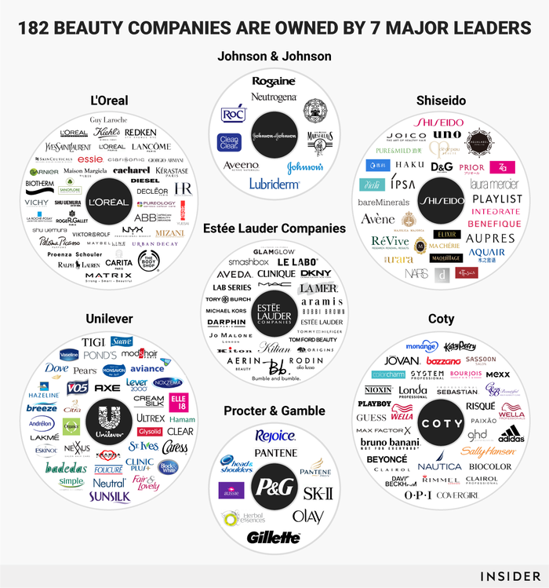
What next?
Tap into organic product segments
Invest in sustainability programs in the context of growing environmental and social challenges.
Come up with products that are geared towards the middle class as well and offer low pricing products.

Slide 8

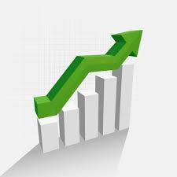
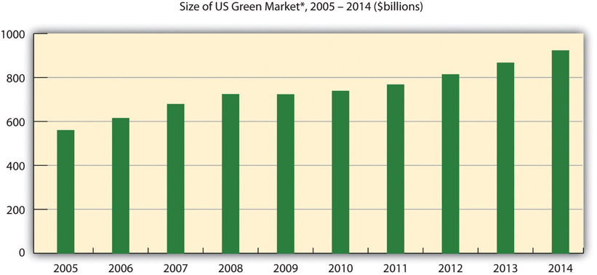
To sustain Company’s Leadership Position
Expand your influence
Build new bonds
Work on Sustainability
Show more care on product quality
Better understanding of market segments
Have a healthy market competition
Continue exploring into new markets

Slide 9
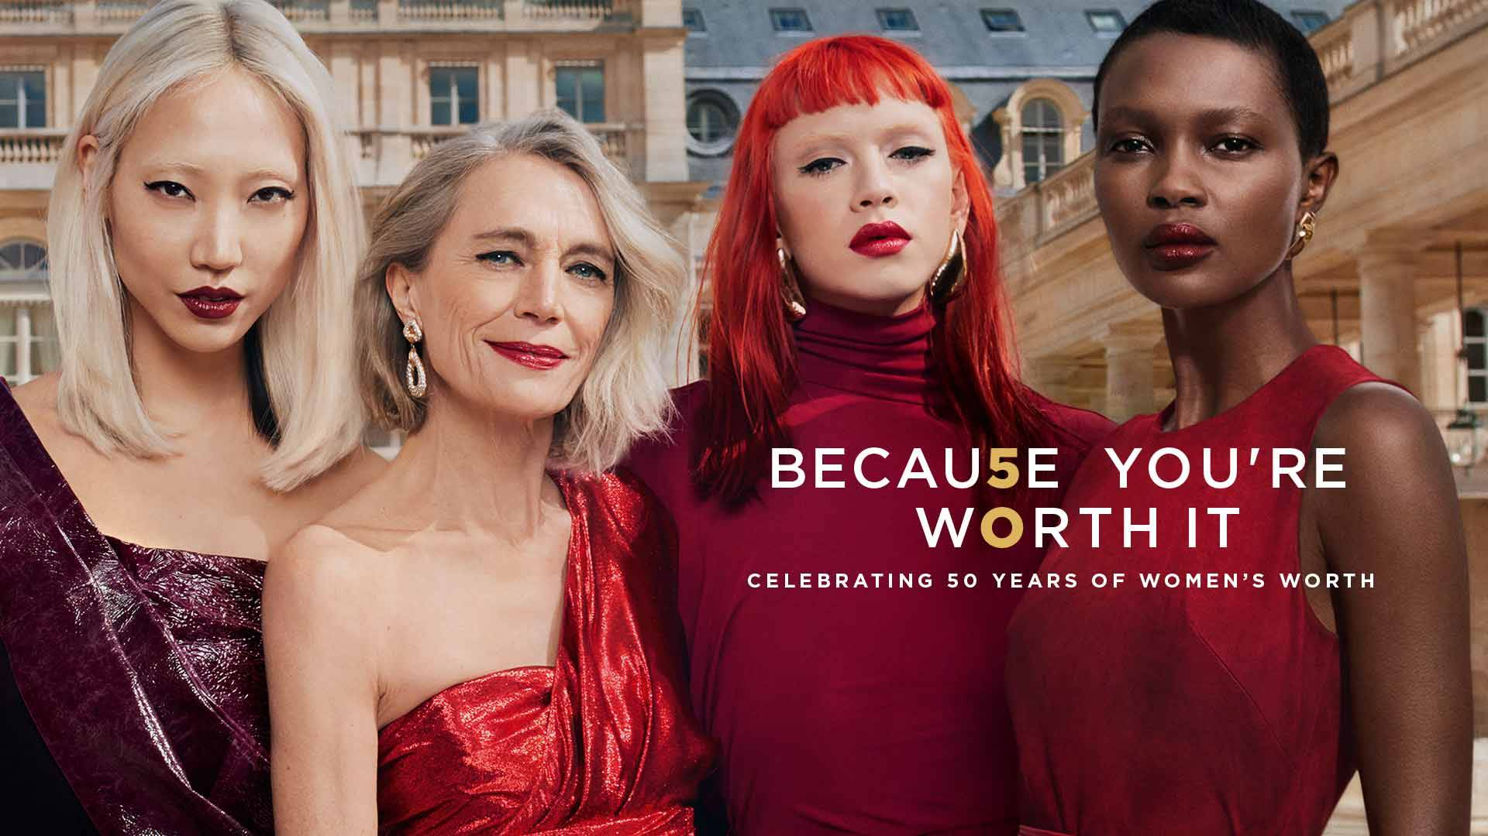
Thank you

